Slide 1


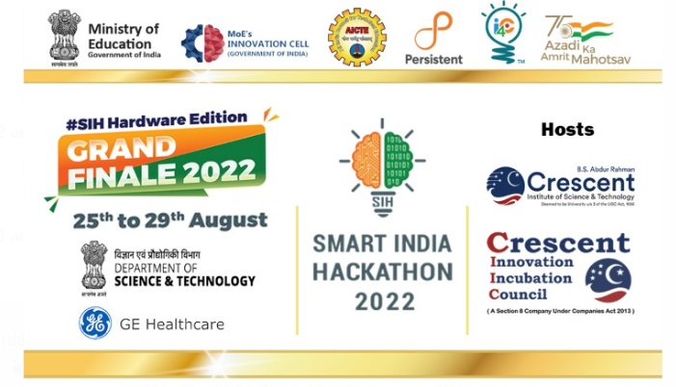


Mentor
Prof. G R K D Satya Prasad

Slide 2
Problem Statement given by
Department of Science & Technology (DoST), Ministry of Science and Technology.
Problem Statement Title:
Smart Networks for Renewable Integrated Sources for standalone Microgrids
Category: Hardware PS Number: DA1072
Domain : Renewable / Sustainable Energy

Slide 3
Problem Statement:
Conditioning Monitoring (CM) of electrical system is the process of systematic data collection and evaluation to identify changes in performance or conditioning of the system, or its components, such that remedial action may be planned in a cost effective manner to maintain reliability. It is the process of continuous monitoring of their electrical parameters in order to identify a significant change which is indicative of a developing fault. Different micro-grids groups have been developing their own remote maintenance and diagnostic units on engineering system of their choice. The appropriate low cost generic tools, providing safe solution are required, to address the challenge for robust and reliable micro grids.

Slide 4
Approach to solve towards Problem Statement:
Definitions of the Microgrid, DC Microgrid, AC Microgrid, Hybrid AC/DC Microgrid
Different groups of micro-grids
Condition monitoring, Systematic data collection, Continues monitoring
Performance monitoring, remedial action and cost effective manner
Own remote maintenance and diagnostic units
Low cost generic tools with safe solution for robust and reliable microgrids

Slide 5
Definition of Microgrid:
A small network of electricity users with a local source of supply that is usually attached to a centralized national grid but is able to function independently.
Definition of DC Microgrid:
A DC microgrid is a localized power system that can run independent of the main power grid by generating and utilizing its own DC power. The most common ways of generating power for DC microgrids are with solar panels, and wind turbines with any excess energy stored in batteries
Definition of AC Microgrid:
AC microgrids connect the various energy generation sources and loads in their network using an AC bus system. Typically, AC microgrids consist of distributed generation sources such as renewables, and conventional power generation sources

Slide 6
Definition of AC/DC Microgrid:
Hybrid AC/DC MICROGRID is also an independent power generation system involving an interface system scheme between the power generation source (hybrid Renewable energy sources and conventional power plants) , energy storage units (batteries /capacitors) and the load demand.
The power electronics converter (system interface scheme) is being adopted between the energy source and load demand depending on whether the loads are DC loads (rectifier), power frequency AC loads (bidirectional converter) , AC loads (inverter) which could be sharing a common DC or AC bus together , depending on its configuration, however it can be an off grid or grid connected.

Slide 7
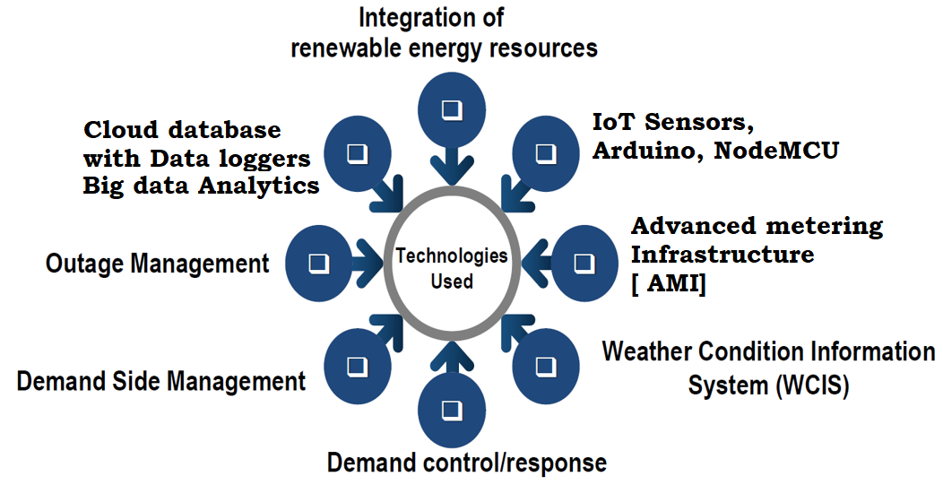
Technologies Used to solve “Problem Statement”

Slide 8
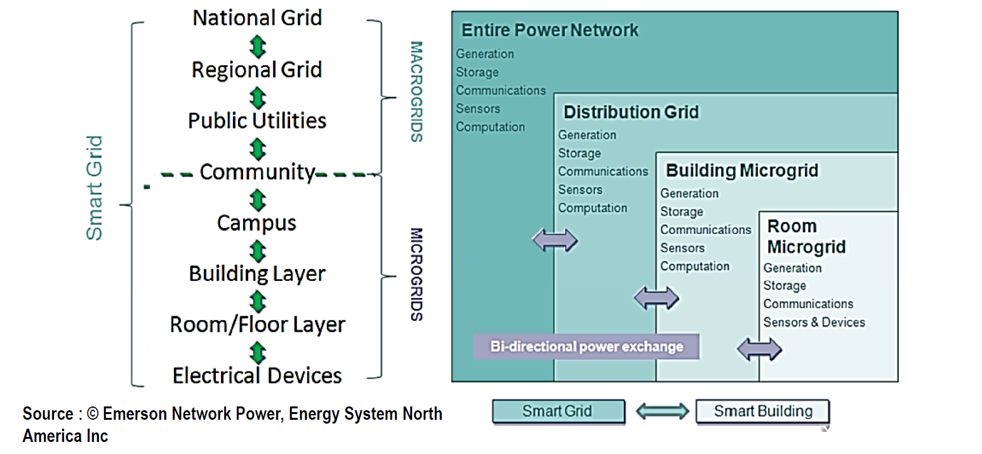

Slide 9
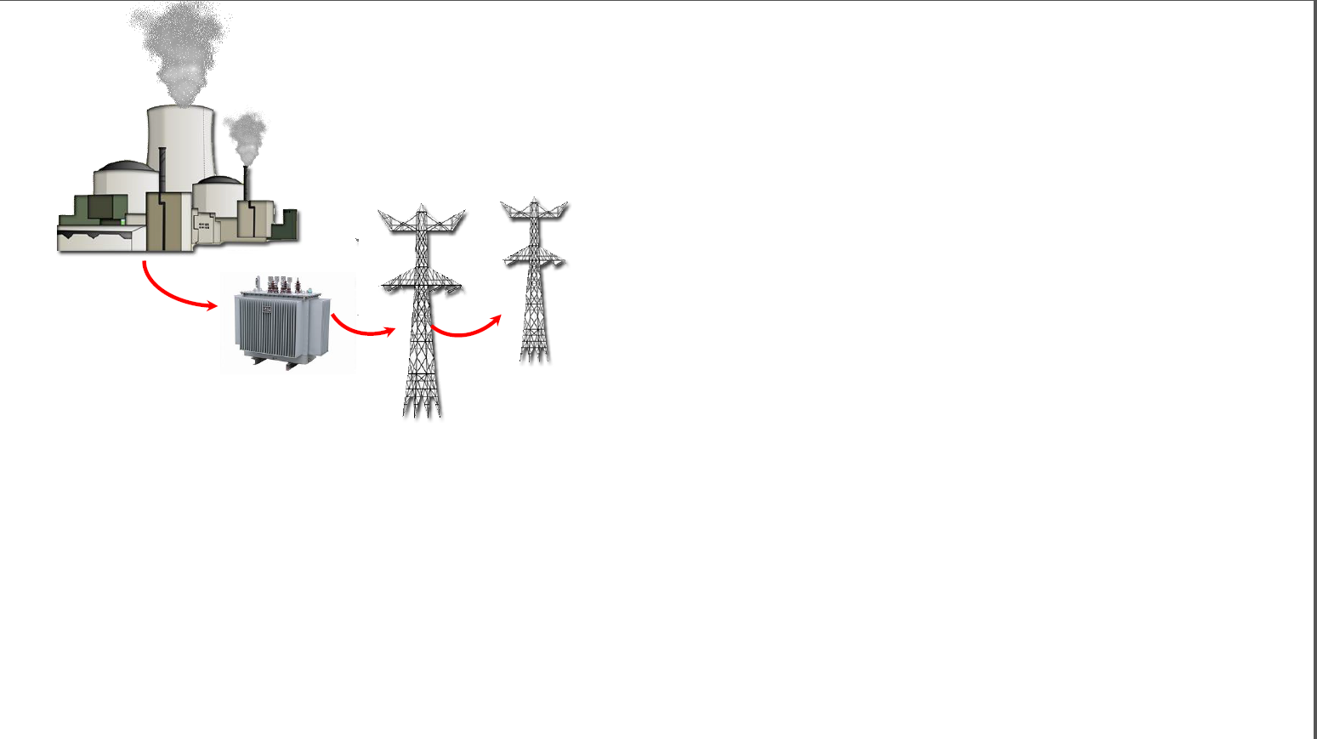
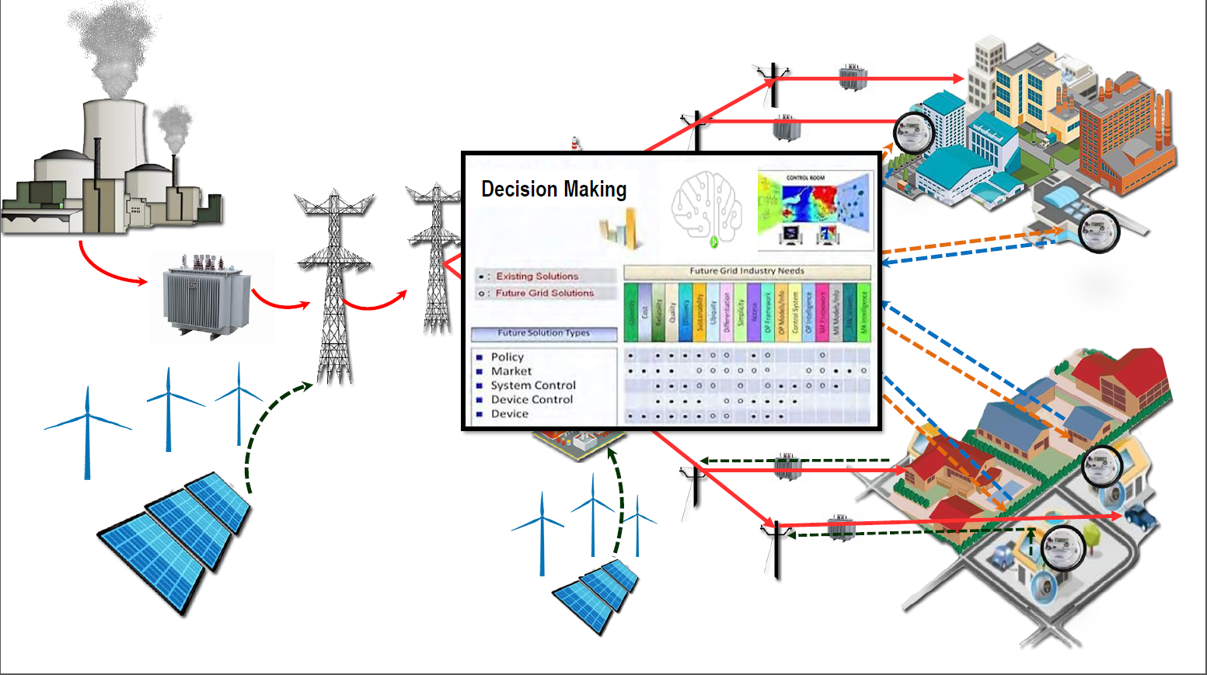
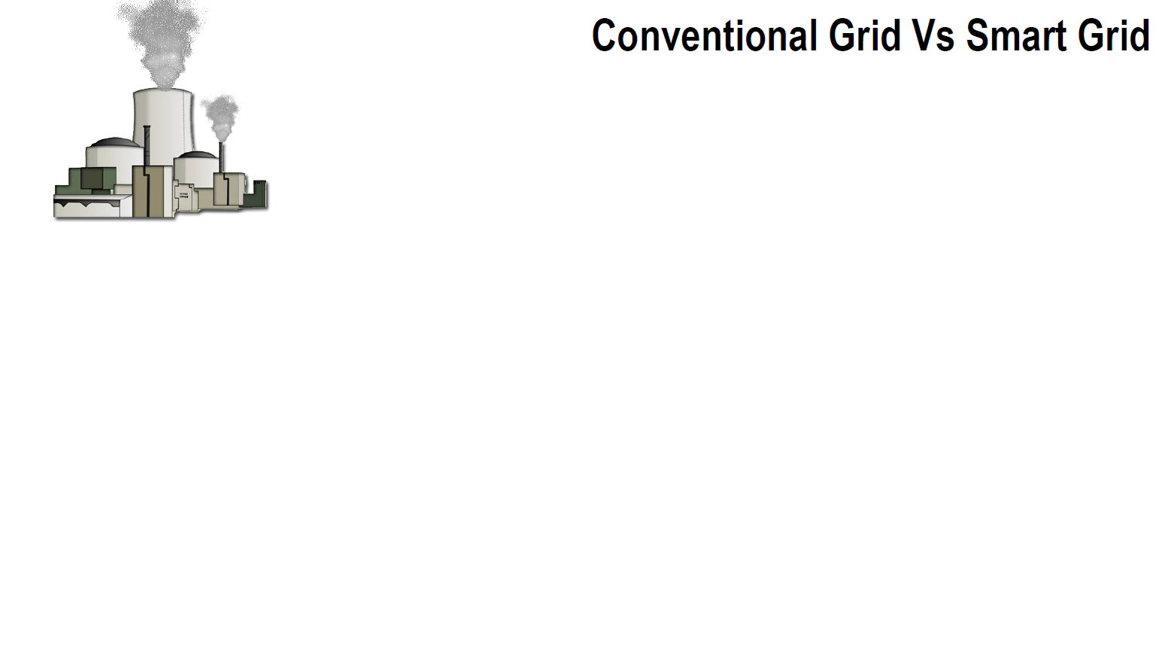

Slide 10
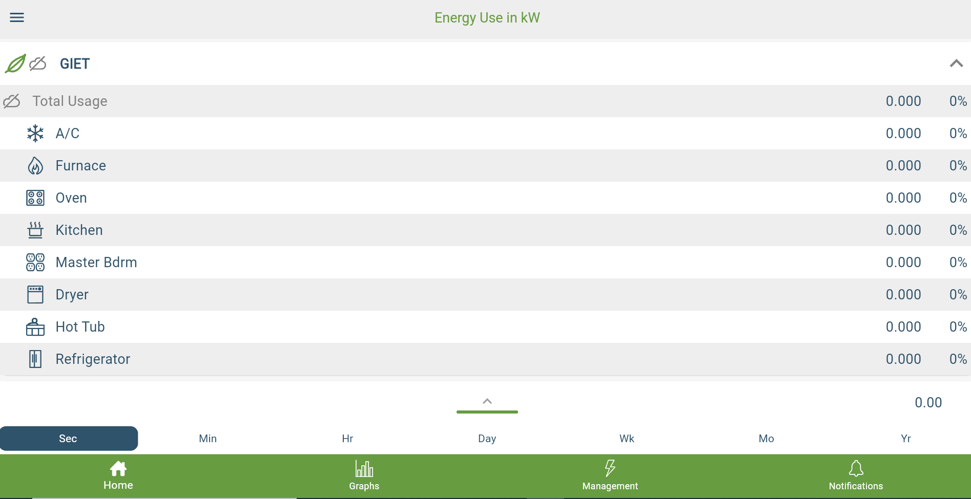
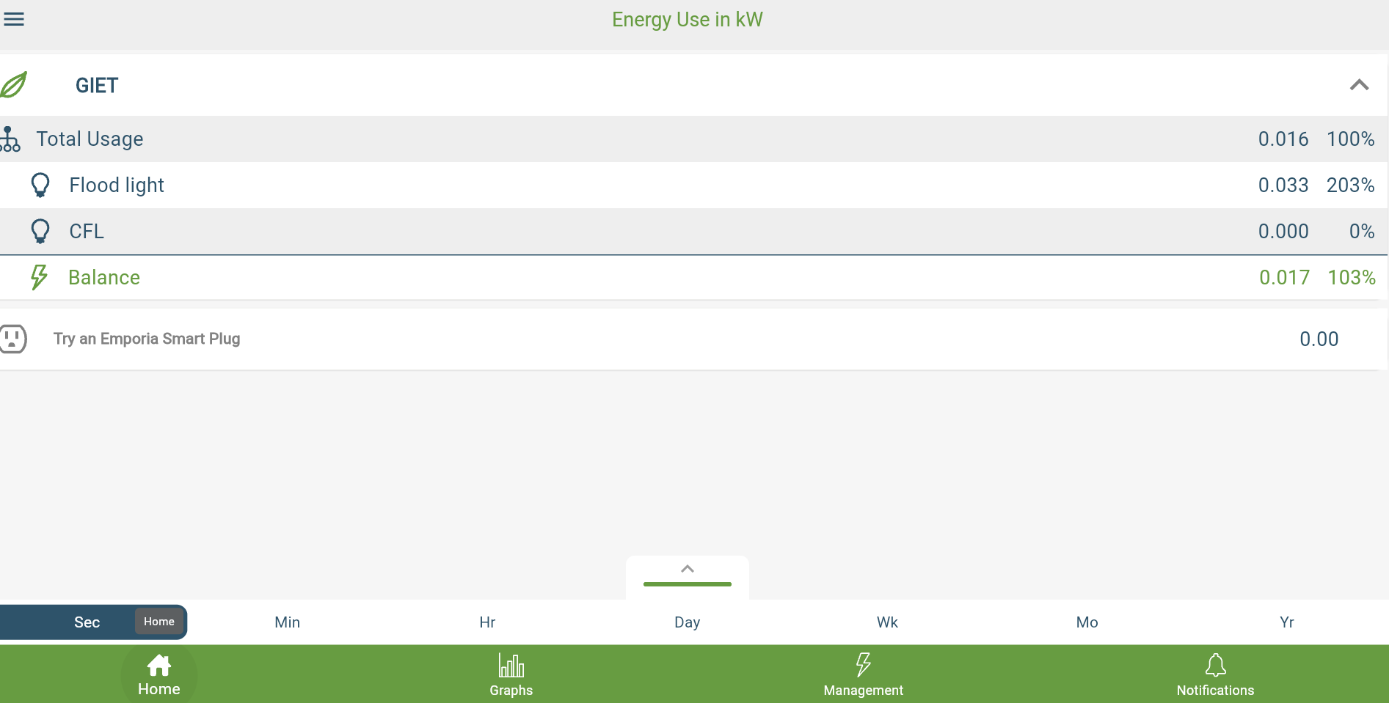

Slide 11
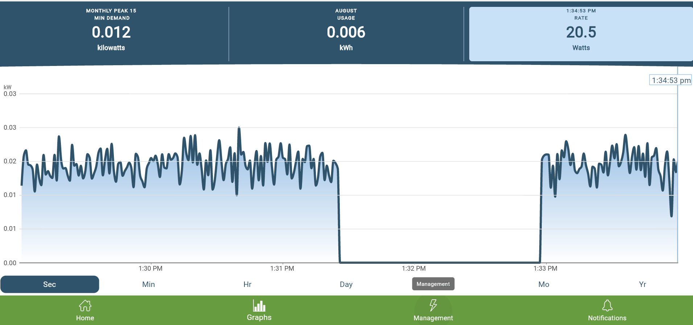

Slide 12
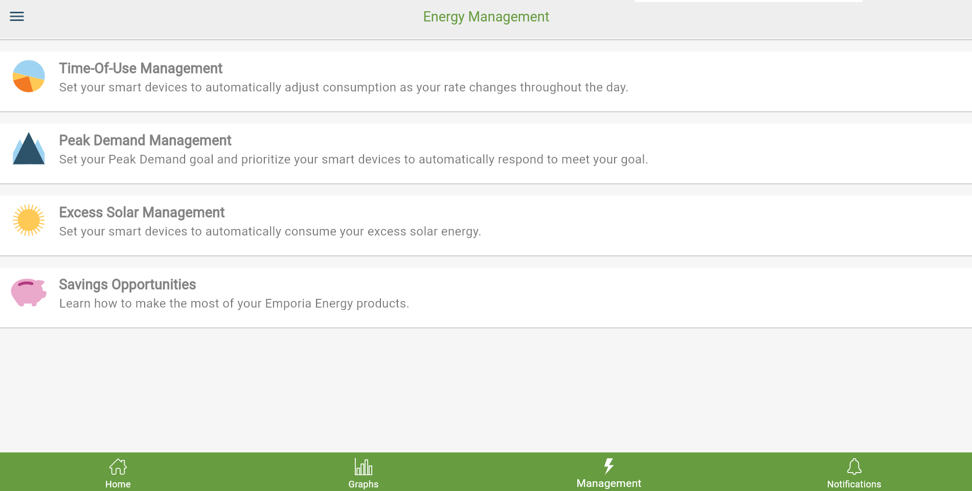

Slide 13
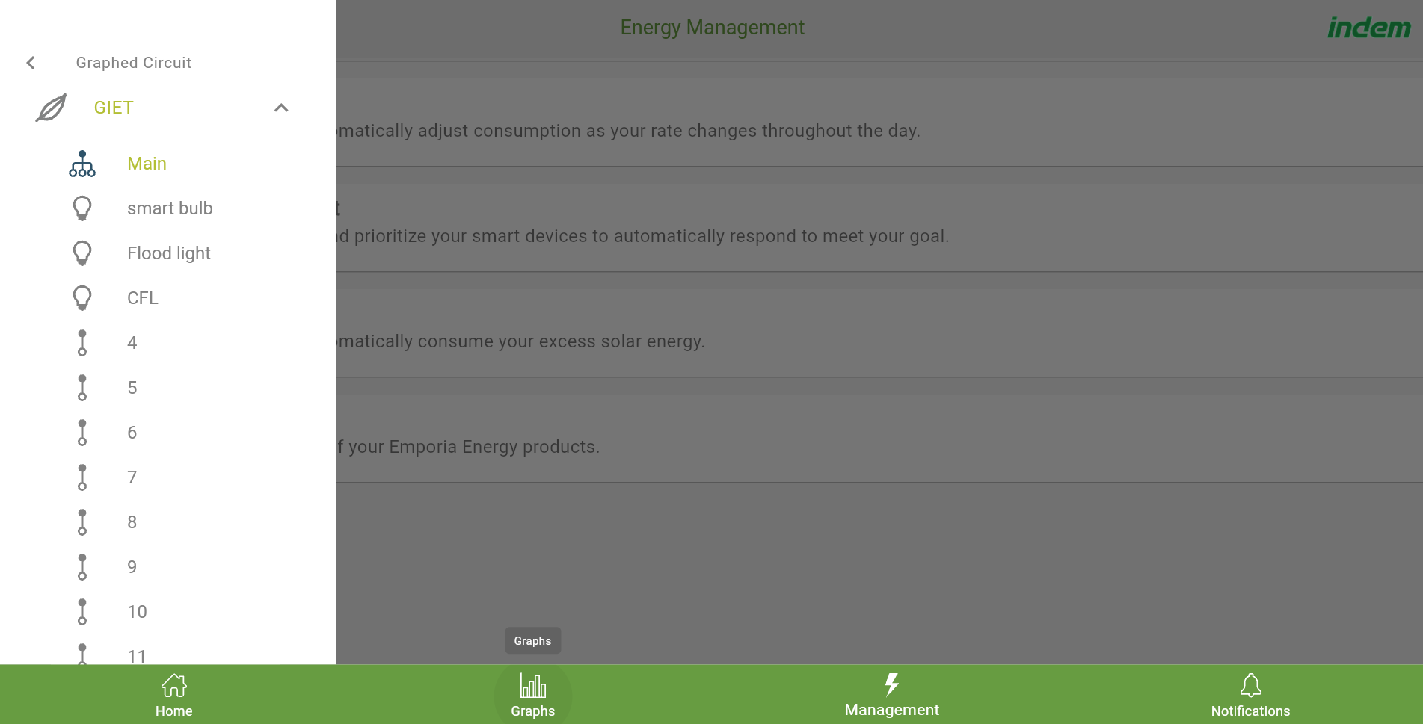

Slide 14
Analysis can be done with software and Hardware setup [ Opensource software with low cost
Model-driven microgrid solution supported with full AC & DC analysis
Detailed modeling, simulation and optimization of microgrid system in study mode
graphical and scripting tools to develop and test control logics and user-defined functions
Virtualized functions implementation for flexible deployment across multi-platforms
Modeling of renewable sources and distributed resources, such as Solar PV, Wind, DGs, and Energy Storage System (ESS)
Built-in logics for dispatch, islanding and load forecasting
Load and generation forecasting
Automated predictive “what-if” simulation validates controller actions in real-time mode
Utilize archived data for system analysis
Integrated SCADA, ADMS, DERMS and Business Intelligence Dashboards
Incorporate predictive simulations as part of control decisions to achieve maximum system performance
Rugged microgrid controller hardware
Easy to set up and communicate with other microgrid assets
Tools to interact with real-time simulators for Software-in-the-Loop (SIL) and Hardware-in-the-Loop (HIL) testing

Slide 15
Microgrid Controller Applications
Dispatch energy resources
Facilitate transition to islanded mode and back
Supervisory control during islanded mode
Facilitate seamless integration of DERs
Improve the stability of system by supporting the frequency and voltage of the grid
Provide grid management functions: Real and Reactive power support
Load vs. Generation capacity balancing
Fast Load Shedding, Automatic Generation Control and Demand Management

Slide 16
Optimal Microgrid Design & Validation
Optimization techniques to evaluate design feasibility
Configure and compare a variety of scenarios to analyze technical performance
Validate microgrid system design and logic incorporating historical, present, or forecasted conditions
Operational Resiliency
Safeguard against power interruptions
Proactively adapt to system changes, unexpected events and disturbances
Decarbonization & Decentralization
Demand for effective energy sustainability and carbon footprint reduction
Effective management and optimization of distributed generation and load assets
Lower the Cost of Engineering, Operation & Maintenance
Reduce the total cost of ownership (TCO) by reducing the cost of electricity (COE).
Manage and decrease the Operations & Maintenance cost
Ensuring that supply and demand are met and optimized at all times within the agreed and empowered electricity prices and programs.

Slide 17
Optimal Energy Use:
Here’s how you compare:
Your Home: 375 Units
Efficient Home: 240 Units - Rs. 12,000 - 1 year 5 Months
Smart Microgrid Home: 190 Units – Rs. 20,000 – 1 year 9 months

Slide 18
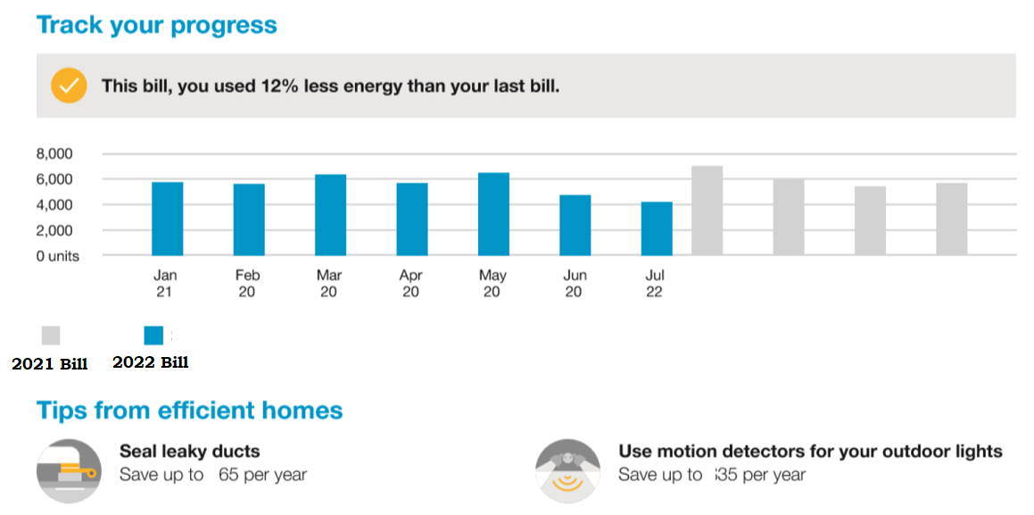

Slide 19
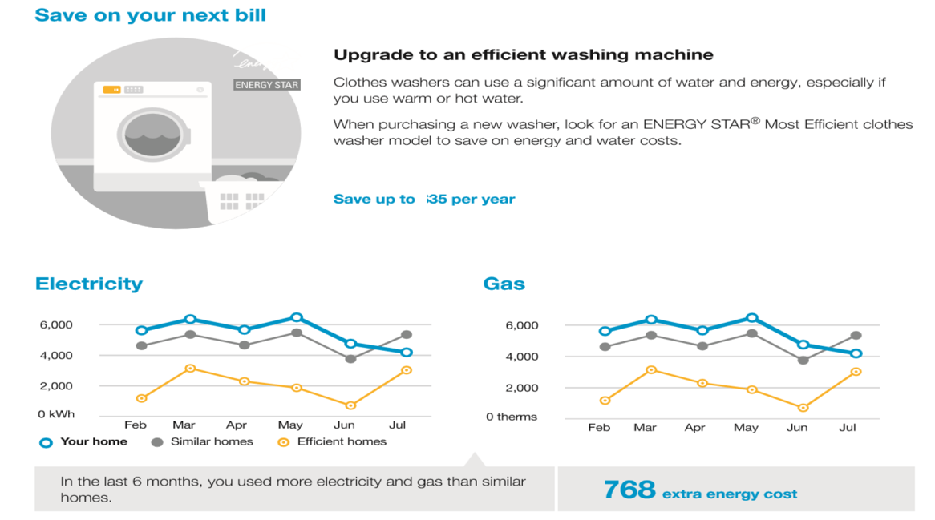

Slide 20
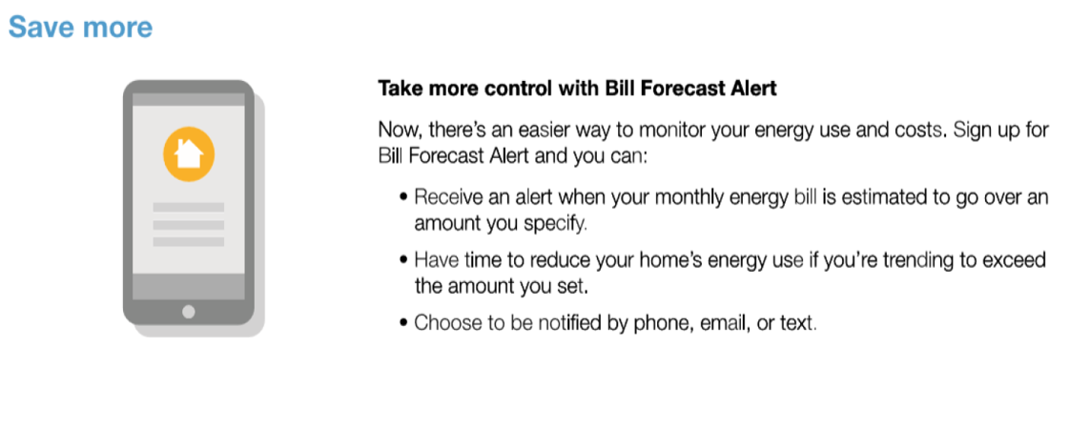

Slide 21
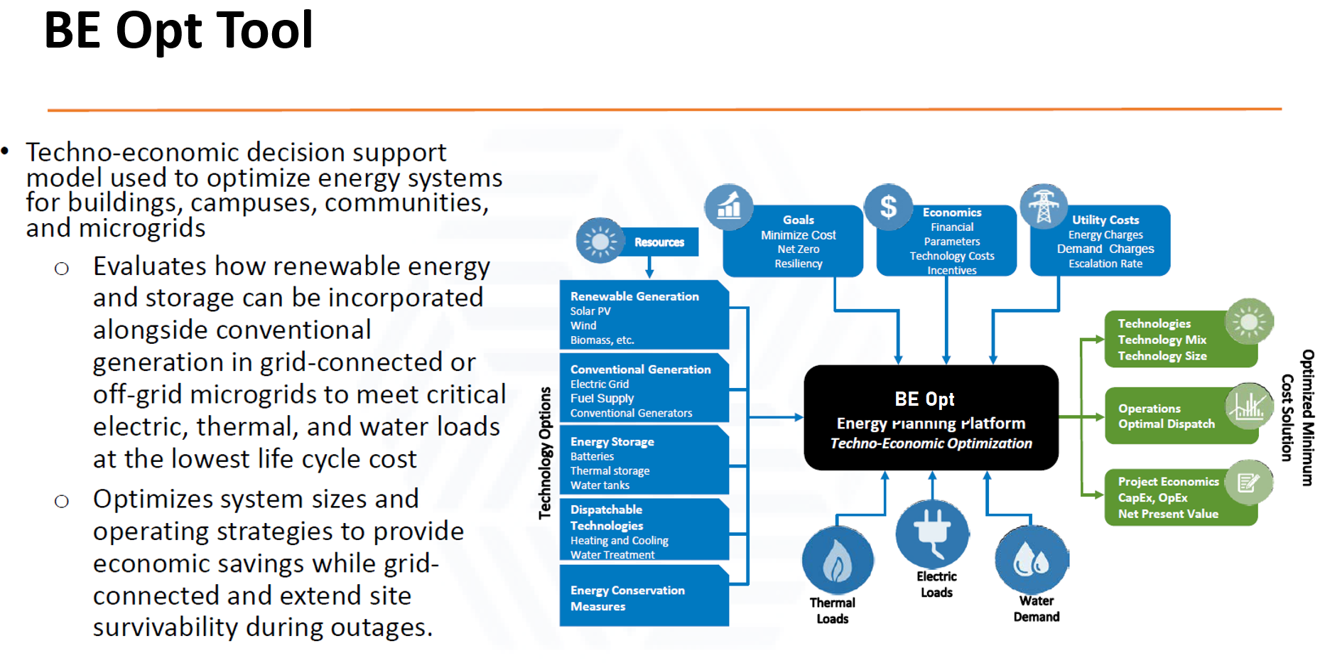
BE Opt Tool

Slide 22
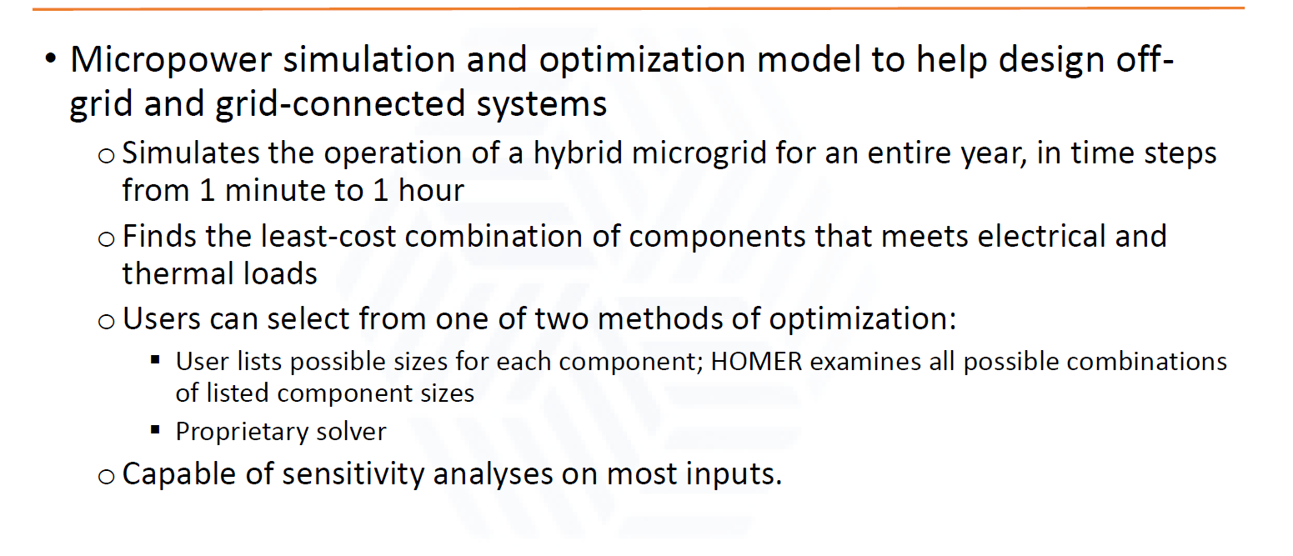
Homer Pro

Slide 23
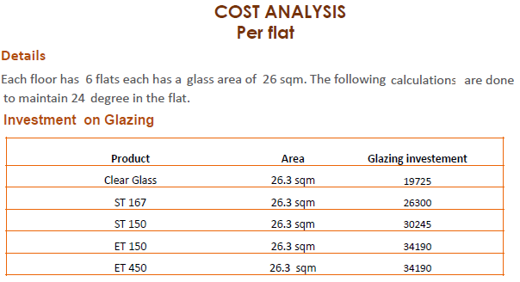
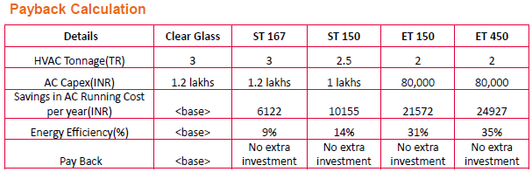

Slide 24
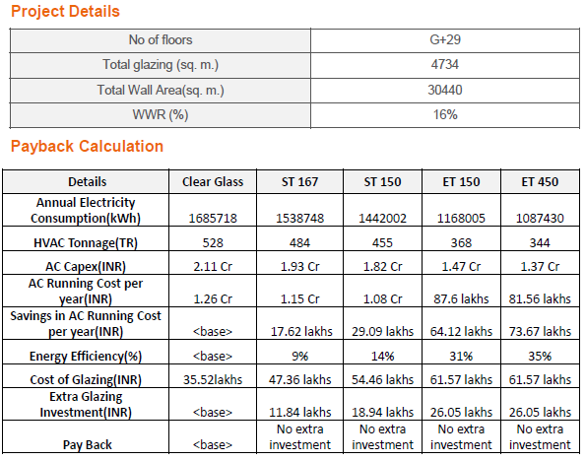
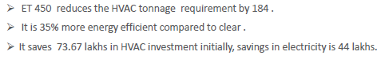

Slide 25
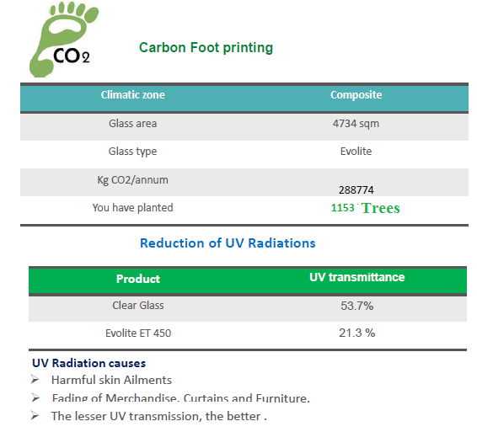

Slide 26
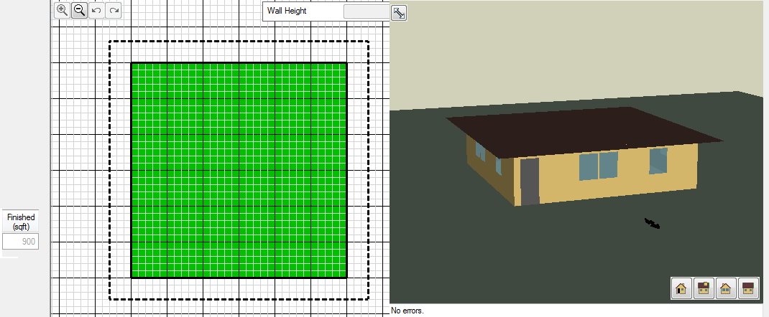

Slide 27
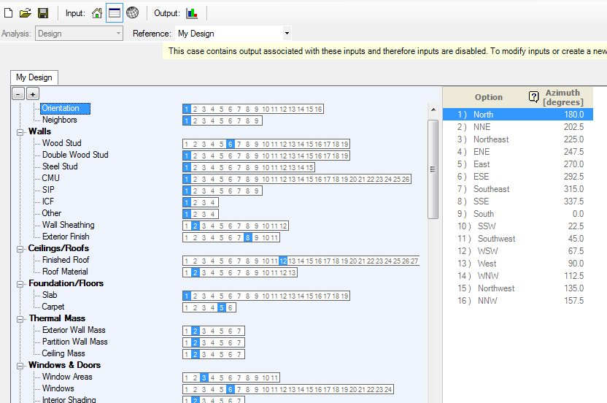
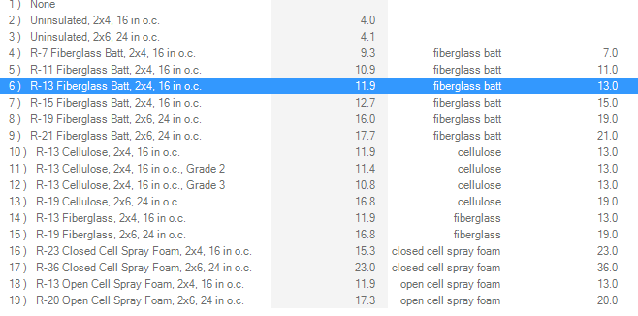
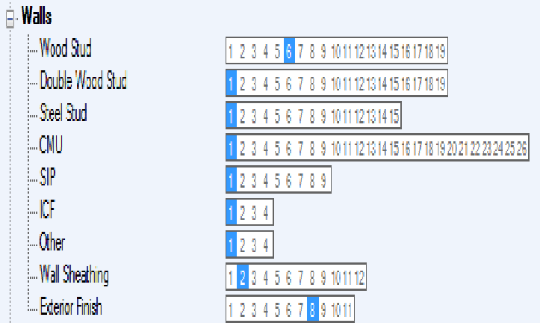
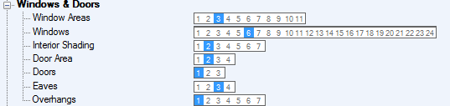

Slide 28
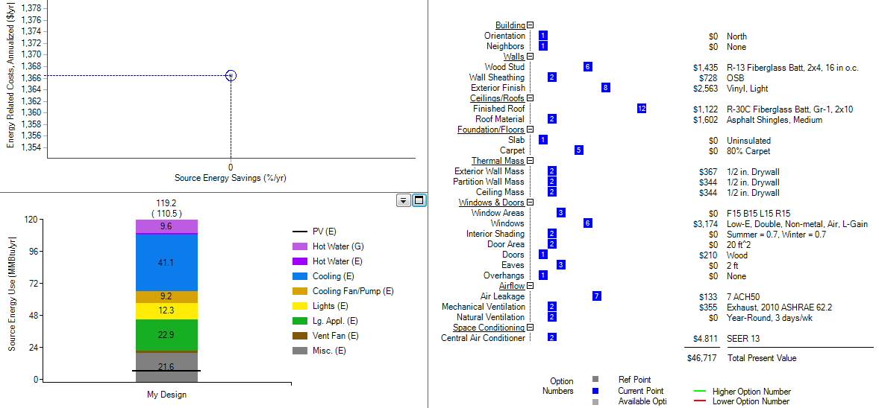

Slide 29
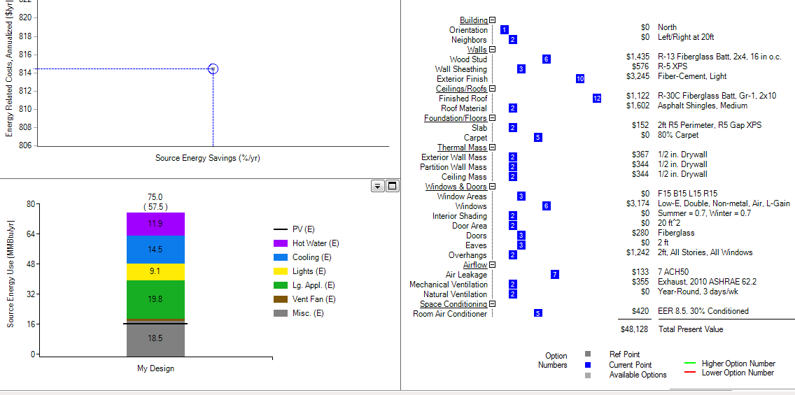

Slide 30
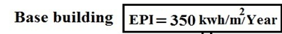
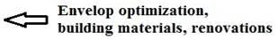
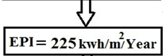
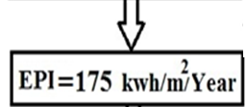
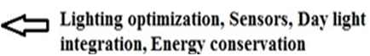
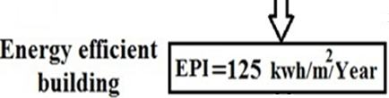
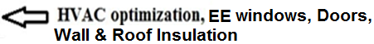
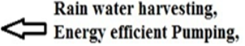
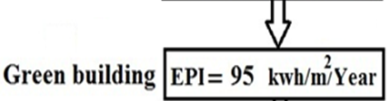
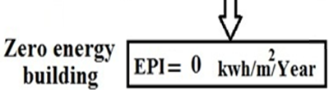
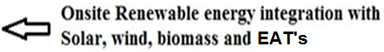

Slide 31
Base Building: 350 EPI
175 EPI

Slide 32
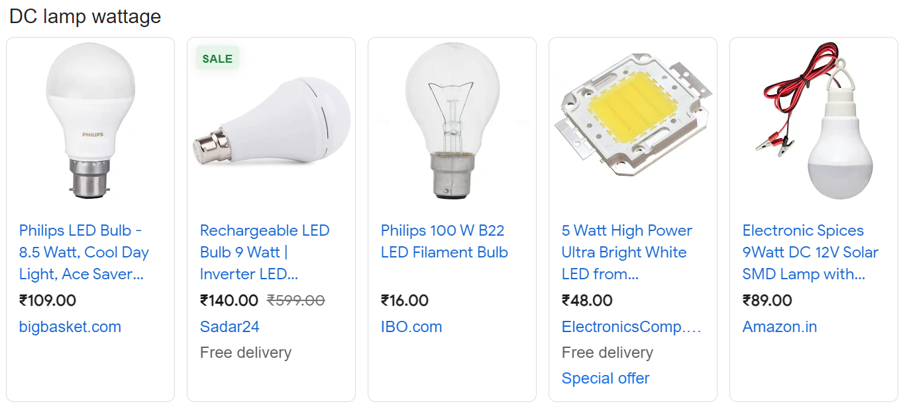

Slide 33
